Slide 1
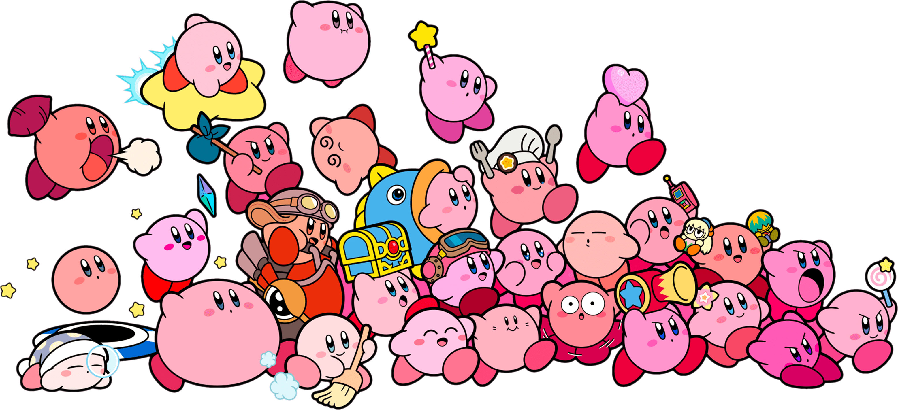
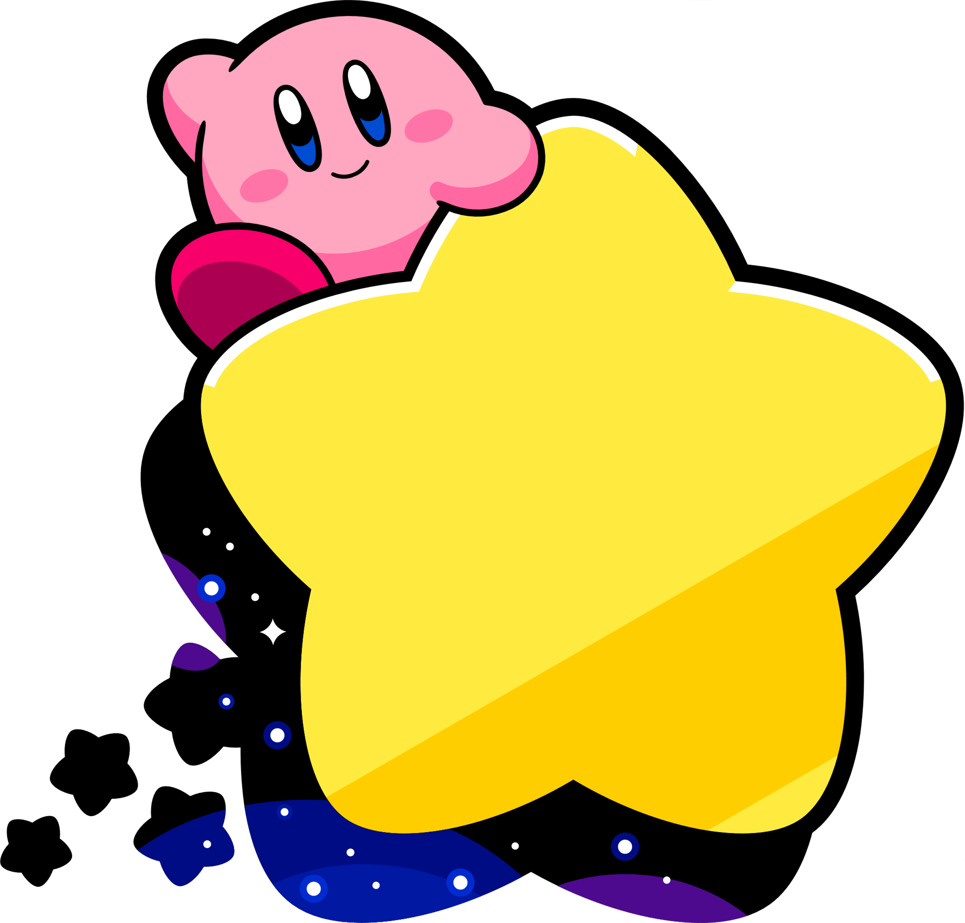

Dream
Importance of
Land

Slide 2

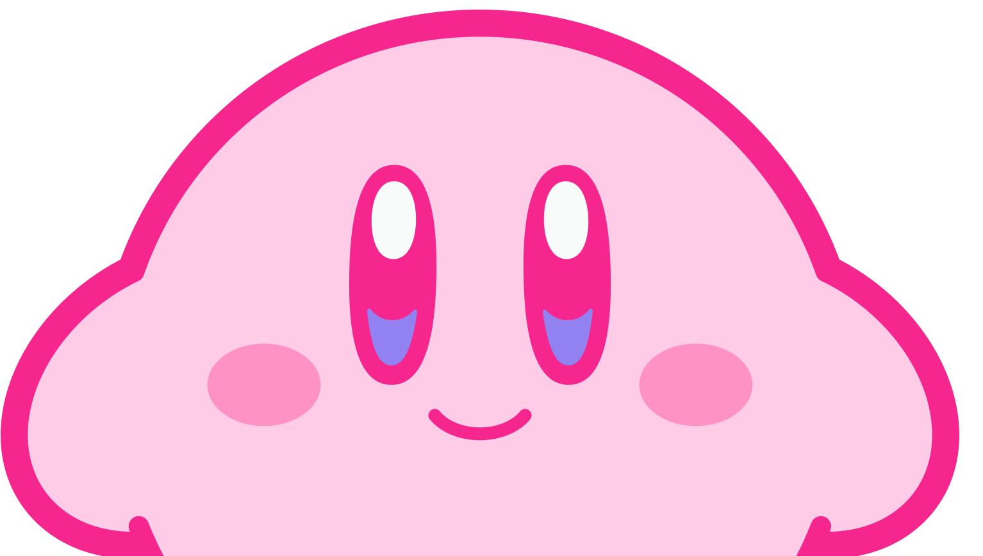
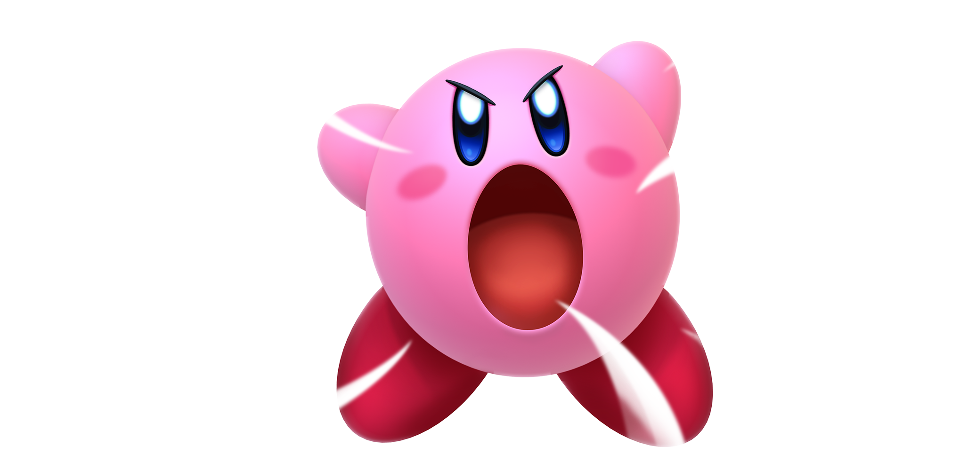
Side effects of liking me
thinking of me all the time
lot of smiles
hallucinations
happiness
missing me

Slide 3
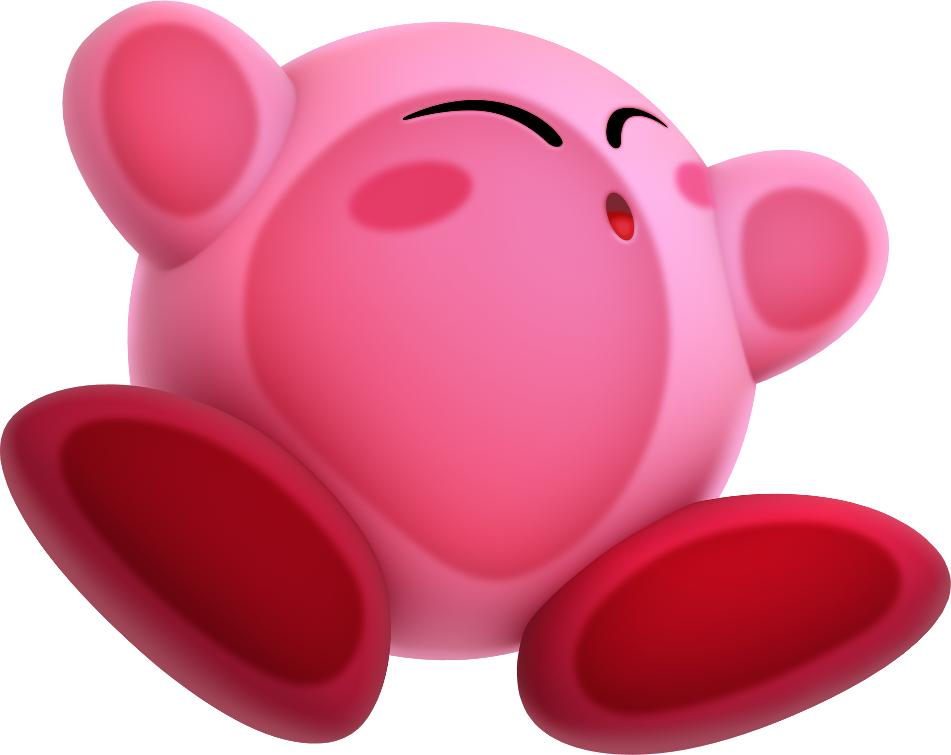
Love can literally make your heart beat faster :P
Once you’ve finished editing your text, move the Kirby back to the center of the slide to make it splat on to the page!
Did you know?

Slide 4
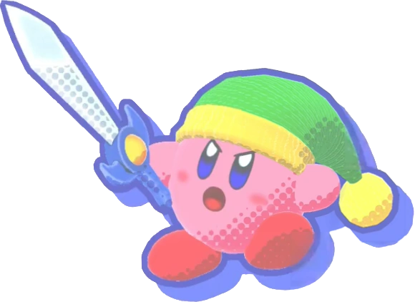
Smart
Reasons why you should like me (totally)
only till you kiss me
Incredibly intelligent and often pose deep theoretical questions that make you think and use your brain for a change.
^

Slide 5
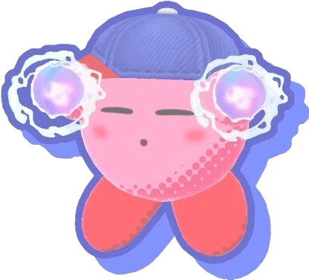
Pretty
Reasons why you should like me (totally)
We’d be the prettiest couple *wink* *wink*
AND we could follow the latest trends and wear matching outfits making people jealous hehe

Slide 6
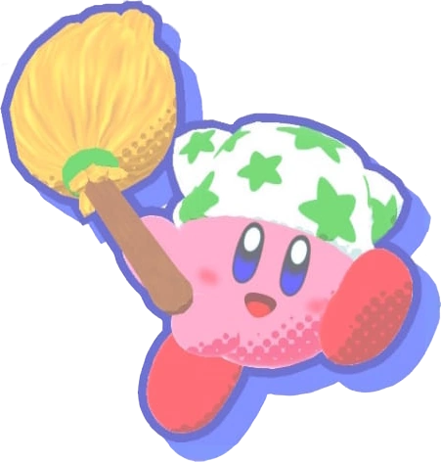
Awesome
Reasons why you should like me (totally)
I am fun to talk to and basically an awesome person. I could tell you funny jokes and stories.

Slide 7
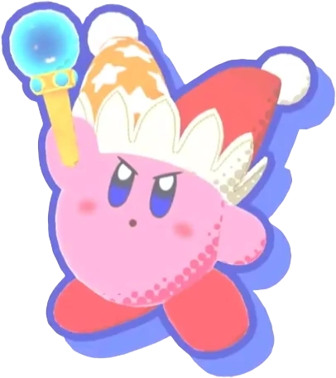
Vibe
Reasons why you should like me (totally)
We are basically the same people, same IQ, same braincells, same everything.

Slide 8
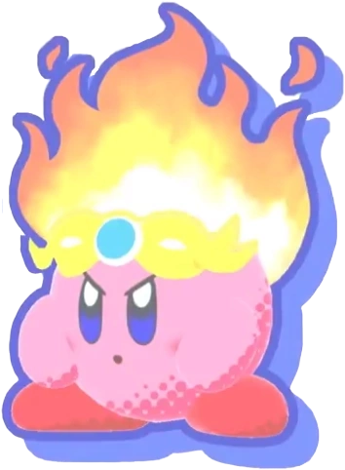
Angy
Reasons why you should like me (totally)
I get mad at you and you don’t even know about it. This would give you an opportunity to improve and avoid making mistakes and think rhetorically.
because im always right

Slide 9
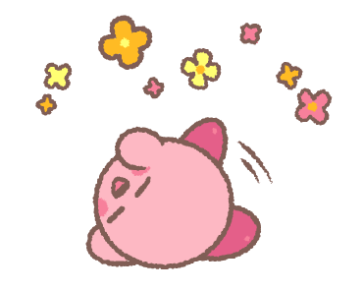

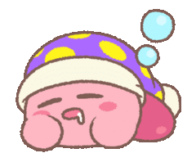


Statistics
9
People who like me
People who LOVE me
People who don’t like me
Sleep peacefully
Have nothing to worry about
Can’t sleep peacefully

Slide 10

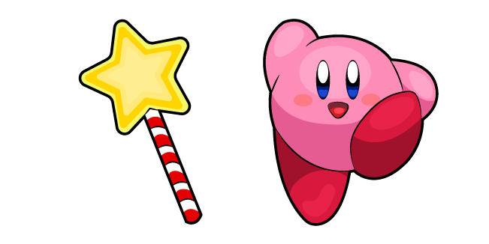
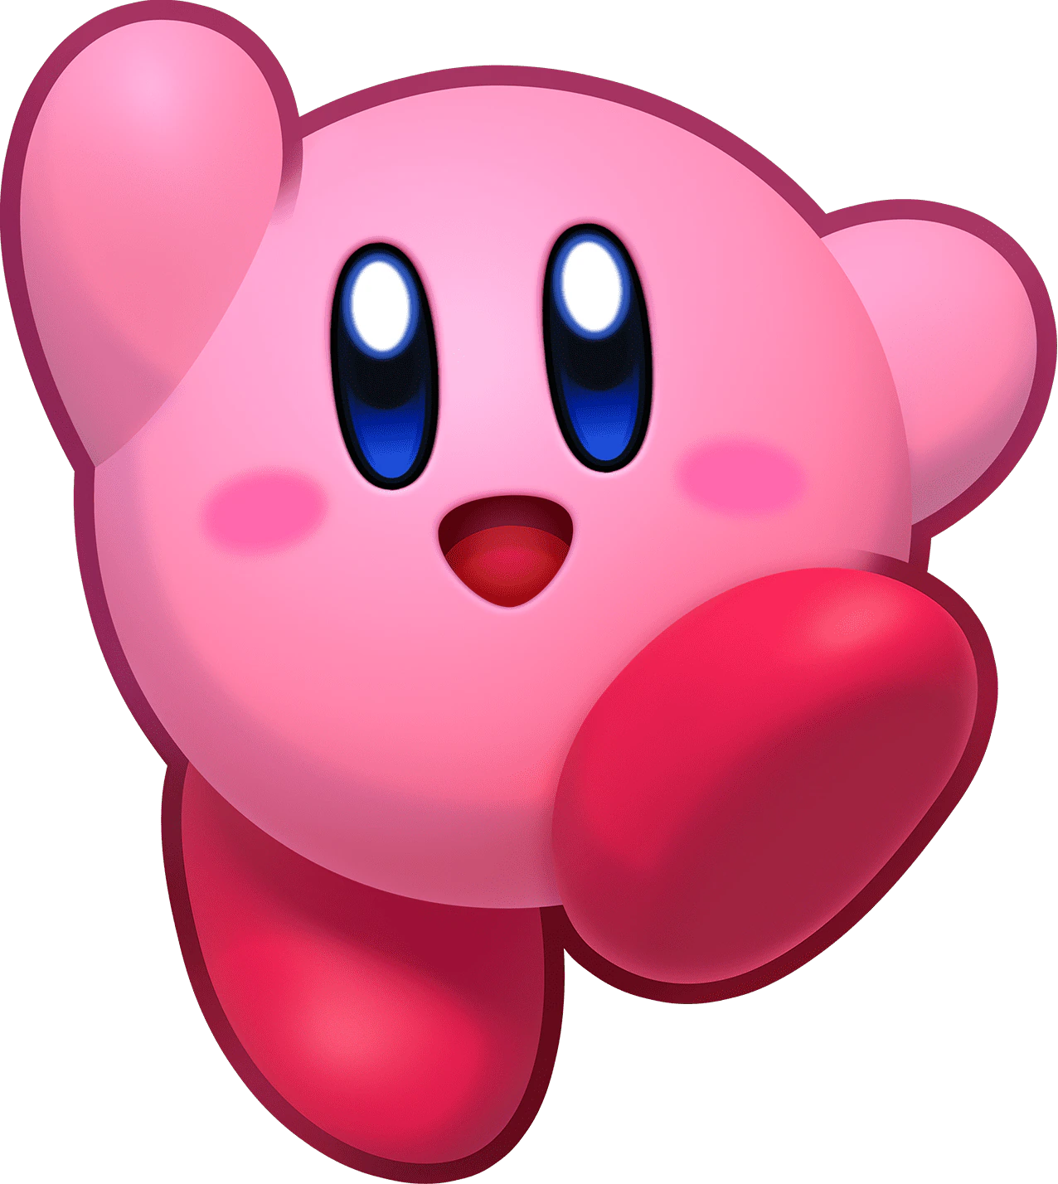
My mind
study
Food
YOU
You (in blue)

Slide 11



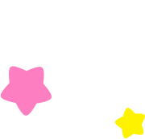




11
Like me
Don’t make me angry
Watch and read all
my stories and texts
Thank you!
How to make me like you

Slide 12
12
Thank you!
Click on the heart
Don’t eat spicy food before bed
Meditate before bed
Don’t watch scary content before bed
How to dream better

